Slide 1
Deep Learning
7. Sequential Models

Slide 2
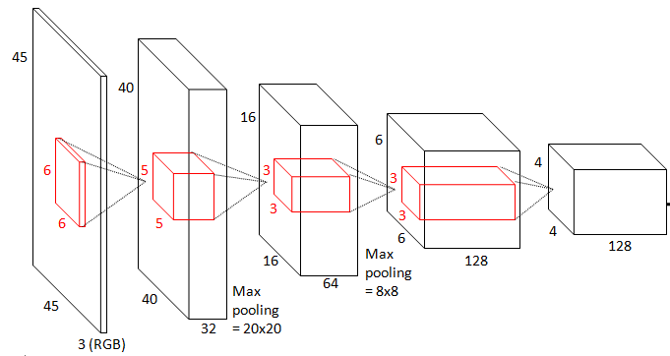
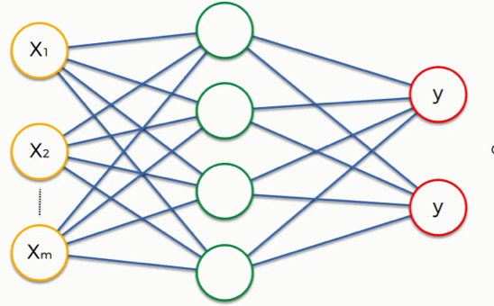
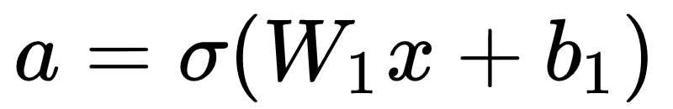
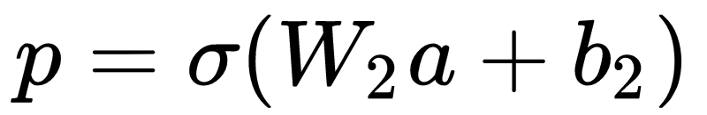
RECAPa
Fully connected network
ConvNet
conv layers
weights
neuron
FC layers
kernel
feature maps
non-linearity
Image from https://www.superdatascience.com/blogs/convolutional-neural-networks-cnn-step-4-full-connection
Image from http://benanne.github.io/images
Notes:
Loss (tipuri si cand se folosesc), backprop, invatare parametrii FCN-> unstructured; Conv -> localized

Slide 3
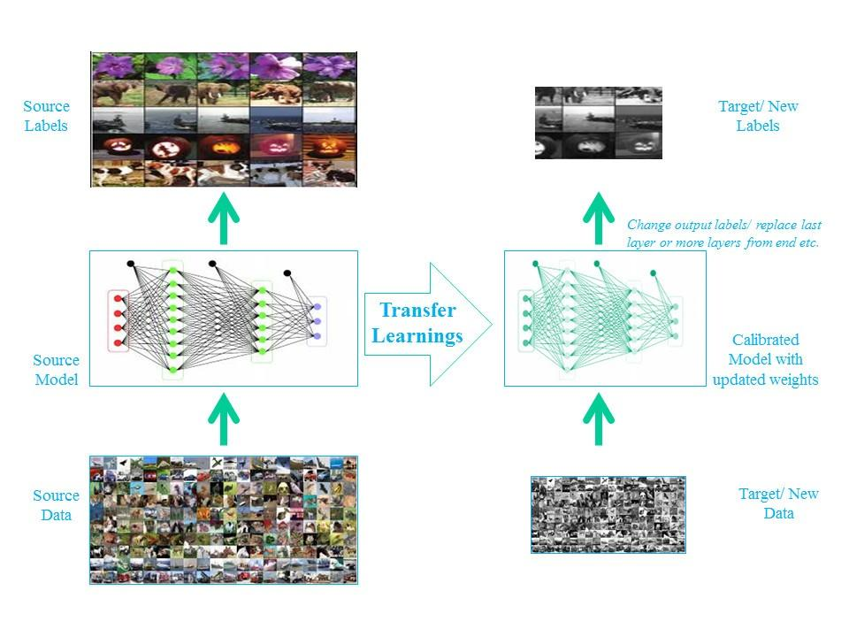
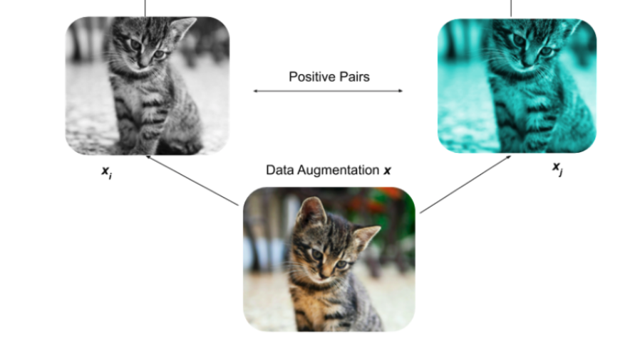
RECAPa
Transfer / Self-Supervision
Photos from: http://deeplearning.net/tutorial/fcn_2D_segm.html; https://medium.com/@wilburdes/semantic-segmentation-using-fully-convolutional-neural-networks-86e45336f99b

Slide 4
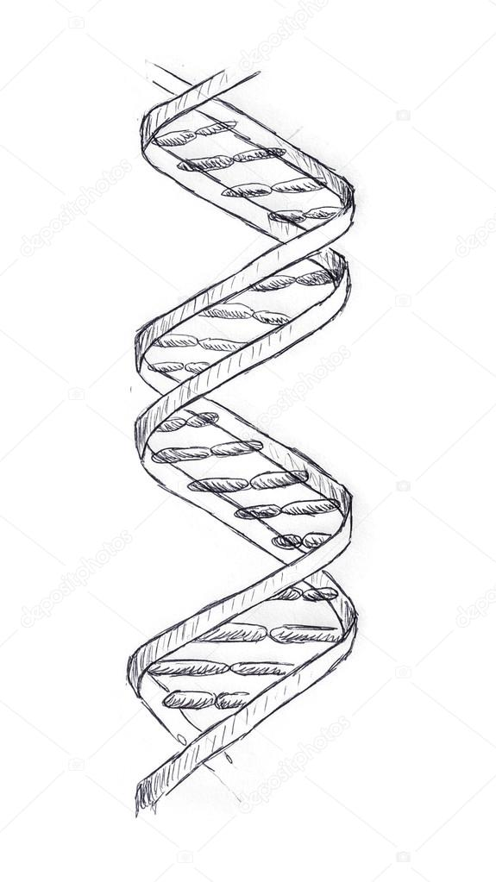


Motivation
Until now we have:
FCN: unstructured data (left)
CNN: localized data (right)
BUT sometimes we have sequential data
Input is a sequence
Output is a sequence

Slide 5
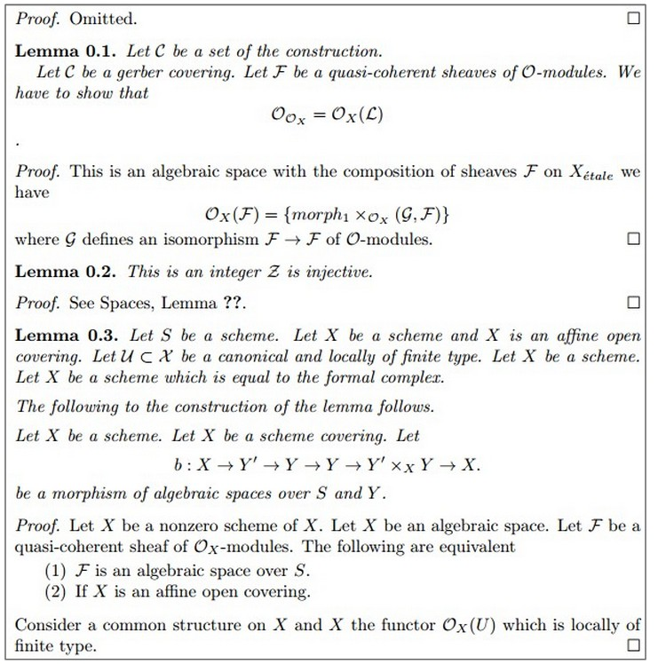
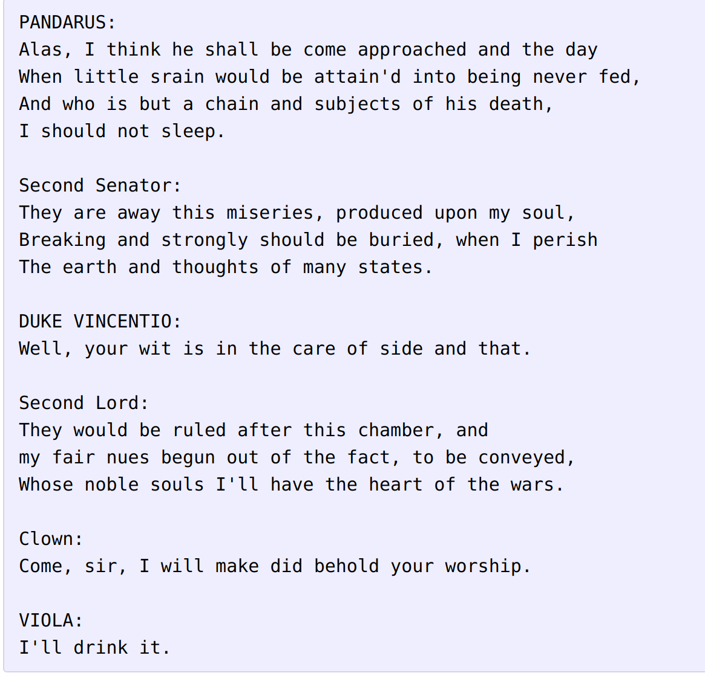
Text generation
A. Karpathy and J. Johnson

Slide 6
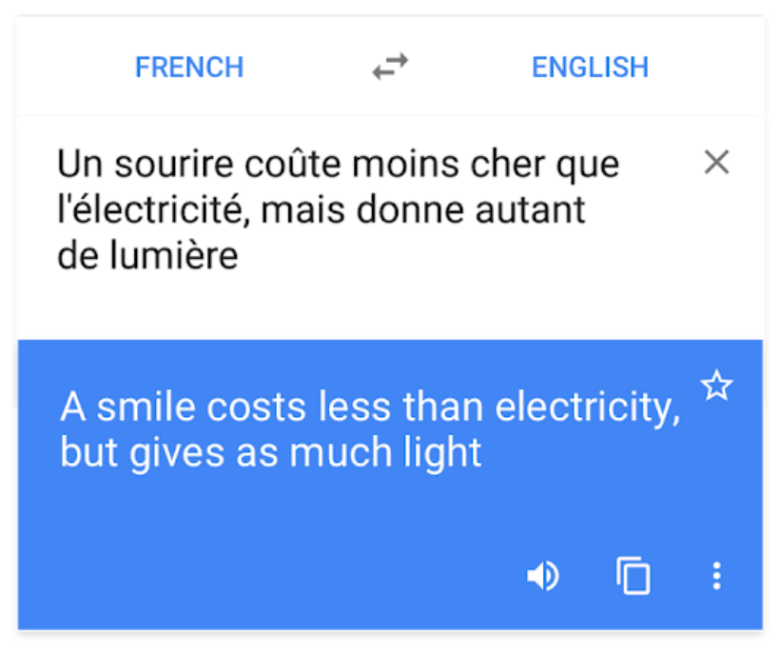
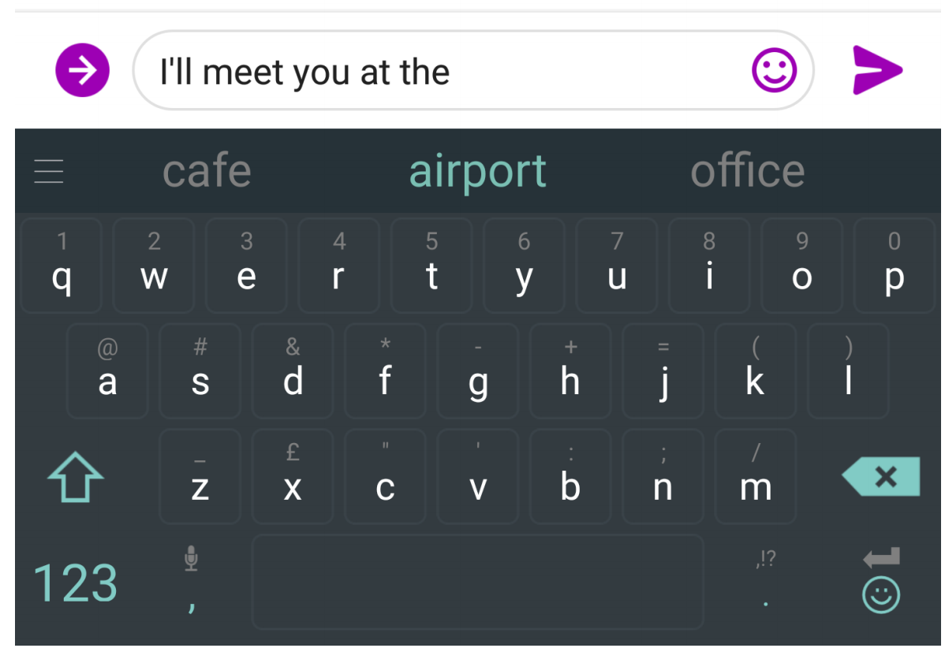
Machine Translation
Wu, Yonghui et al. “Google's Neural Machine Translation System: Bridging the Gap between Human and Machine Translation.”

Slide 7
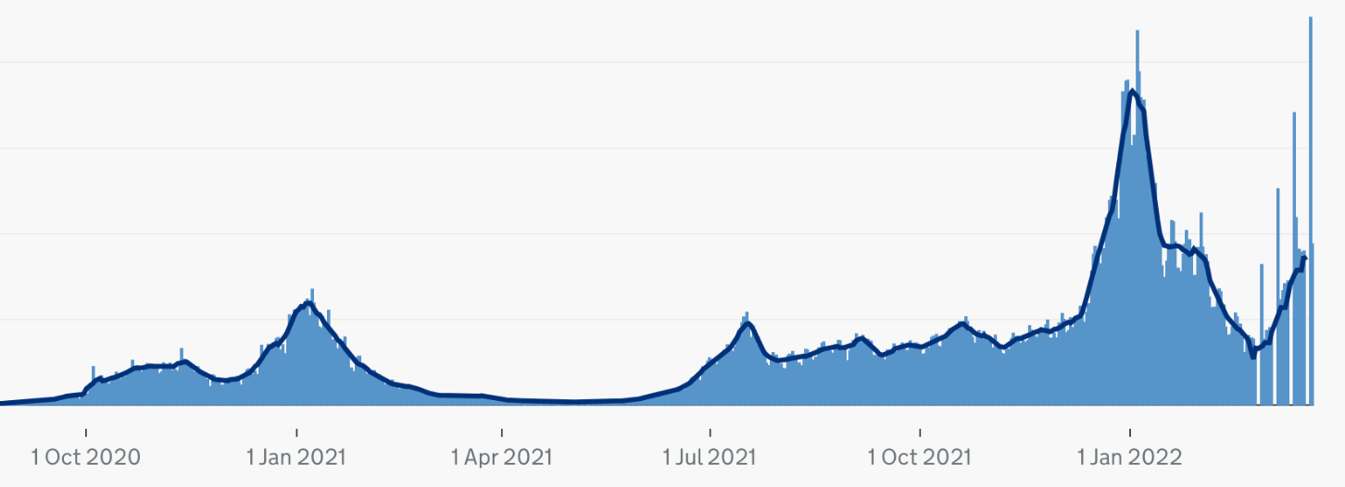
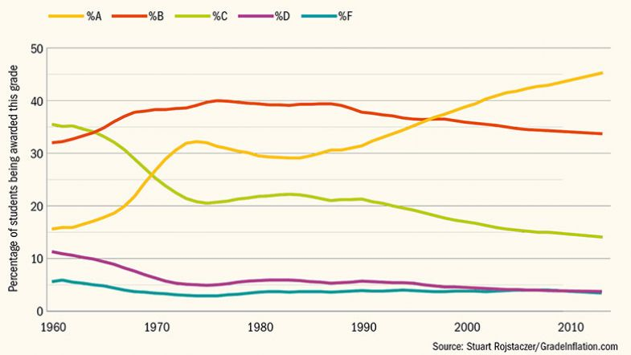

Time series prediction
Number of covid cases in UK
Percentage of students being awarded each grade
ArunKumar et al, Forecasting of COVID-19 using deep layer Recurrent Neural Networks (RNNs) with Gated Recurrent Units (GRUs) and Long Short-Term Memory (LSTM) cells
Patil et al, Effective Deep Learning Model to Predict Student Grade Point Averages, ICCIC 2017
Graphics: https://coronavirus.data.gov.uk/details/cases https://coronavirus.data.gov.uk/ Image: https://nouvelles.umontreal.ca/en/article/2020/05/01/
far-more-cases-than-officially-reported/; https://www.timeshighereducation.com/features/grade-inflation-worldwide-trend

Slide 8
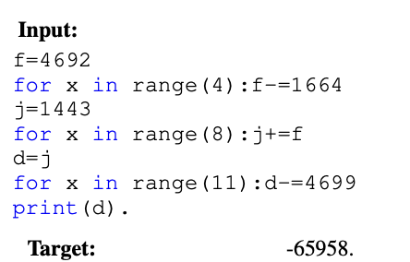
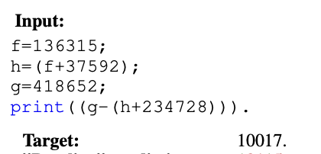
Learning to execute
Zaremba, et al. "Learning to execute." arXiv preprint arXiv:1410.4615 (2014)

Slide 9
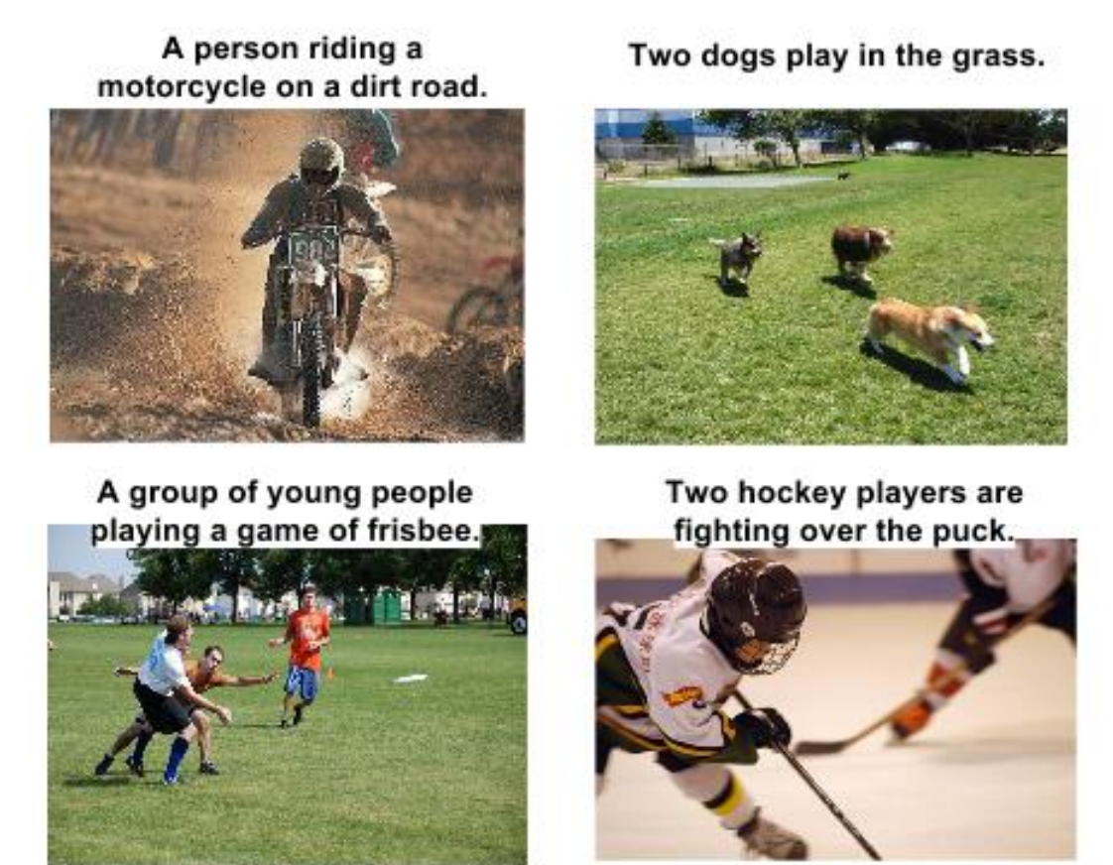
Captioning
O. Vinyals et al. “ Show and Tell: A Neural Image Caption Generator”(2015).
I. Duta, A. Nicolicioiu, V. Bogolin, M. Leordeanu . “Mining for meaning: from vision to language through multiple networks consensus”(2018).

Slide 10
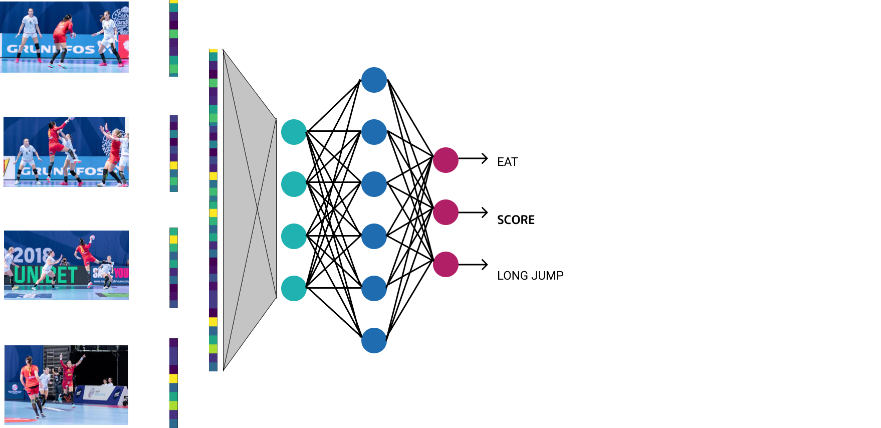
Video classification:
Notes:
Ce dimensiune au features-urile pe fiecare frame?
Ce dimensiune are reprezentarea videoului?
Folosim CNN-uri diferite pentru fiecare frame sau le shareuim?

Slide 11
Video classification:
for each frame extract features using CNN
concatenate all the features in a huge video representation vector
Notes:
Ce dimensiune au features-urile pe fiecare frame?
Ce dimensiune are reprezentarea videoului?
Folosim CNN-uri diferite pentru fiecare frame sau le shareuim?

Slide 12
Video classification:
for each frame extract features using CNN
concatenate all the features in a huge video representation vector
process the video representation using fully connected layers

Slide 13
Video classification:
Why not?

Slide 14
Video classification:
Why not?
∈ R^{(d1*f) x d2}
W1

Slide 15
Video classification:
?

Slide 16
Video classification:
Why not?
huge number of parameters
∈ R^{(d1*f) x d2}
W1
Notes:
No seq: combina la fel caracteristici ale aceluiasi frame cu cele din frameuri diferite. Invata parametrii diferiti pentru elemente similare (ex. cristina)
Huge params: mai aels in primul nivel pe care nici nu vrei sa il reduci prea mult deci probabil se propaga si mai incolo
Fixed length: depidne de f prima proiectie

Slide 17
Video classification:
Why not?
huge number of parameters
no sequentiality
∈ R^{(d1*f) x d2}
W1
Notes:
No seq: combina la fel caracteristici ale aceluiasi frame cu cele din frameuri diferite. Invata parametrii diferiti pentru elemente similare (ex. cristina)
Huge params: mai aels in primul nivel pe care nici nu vrei sa il reduci prea mult deci probabil se propaga si mai incolo
Fixed length: depidne de f prima proiectie

Slide 18
Video classification:
Why not?
huge number of parameters
no sequentiality
fixed input length
∈ R^{(d1*f) x d2}
W1
Notes:
No seq: combina la fel caracteristici ale aceluiasi frame cu cele din frameuri diferite. Invata parametrii diferiti pentru elemente similare (ex. cristina)
Huge params: mai aels in primul nivel pe care nici nu vrei sa il reduci prea mult deci probabil se propaga si mai incolo
Fixed length: depidne de f prima proiectie

Slide 19
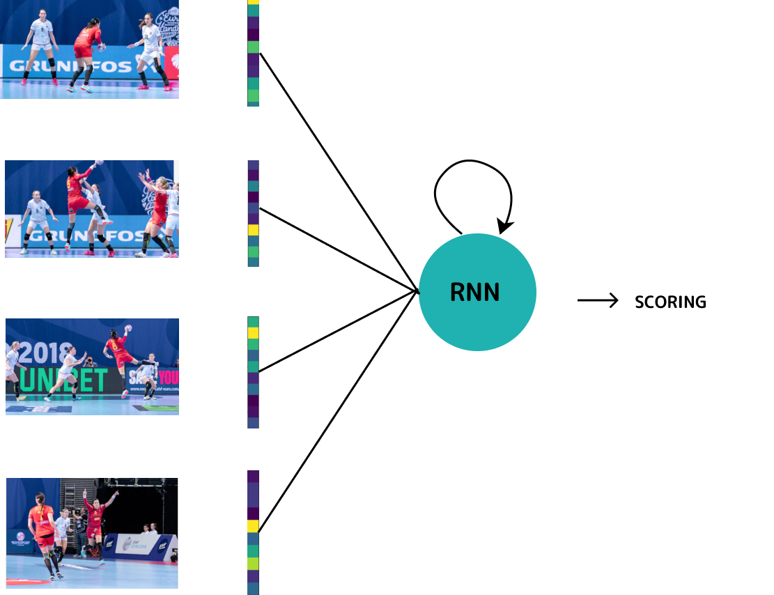
Video classification:
Solution:
Recurrent Neural Network

Slide 20
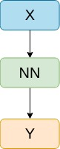
Feed-forward vs RNN
ONE - TO - ONE
Notes:
De dat exemple la fiecare

Slide 21
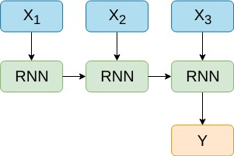
Feed-forward vs RNN
MANY - TO - ONE
ONE - TO - ONE
Notes:
De dat exemple la fiecare

Slide 22
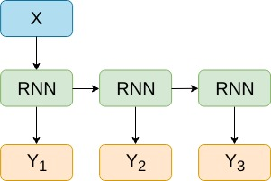
Feed-forward vs RNN
MANY - TO - ONE
ONE - TO - MANY
ONE - TO - ONE
Notes:
De dat exemple la fiecare

Slide 23
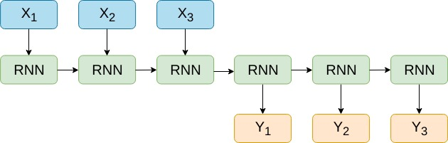
Feed-forward vs RNN
MANY - TO - ONE
ONE - TO - MANY
ONE - TO - ONE
MANY - TO - MANY
Notes:
De dat exemple la fiecare

Slide 24
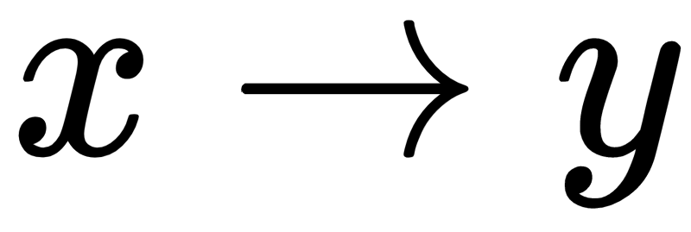
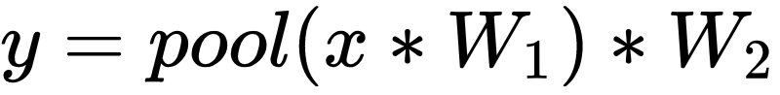
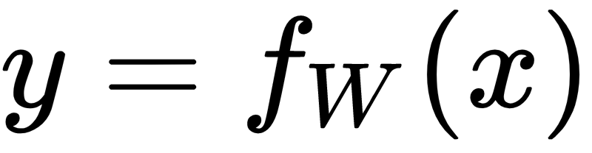
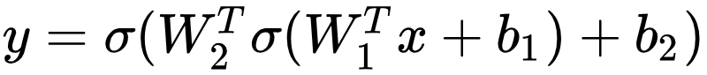
Notes:
Sa vorbesc despre ce inseamna f_w(x) concret

Slide 25
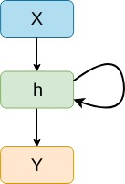

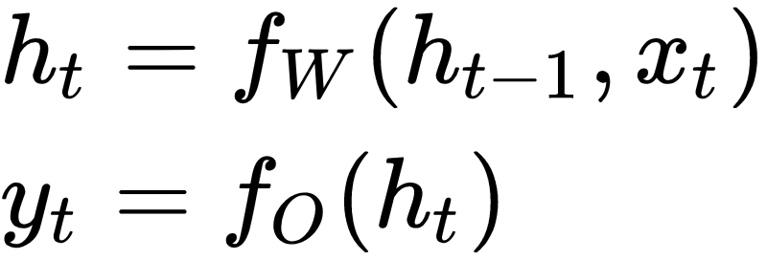
x - input
h - hidden state / context
y - output
Notes:
Sa vorbesc despre ce inseamna f_w(x) concret

Slide 26
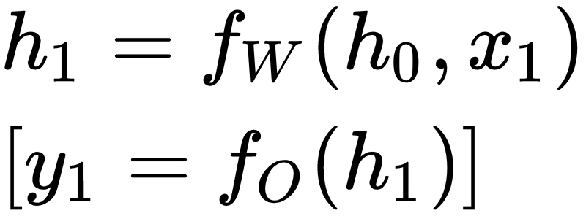
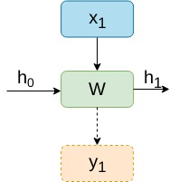
Forward step

Slide 27
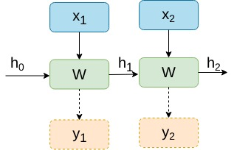
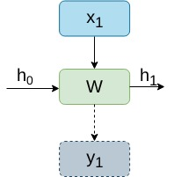
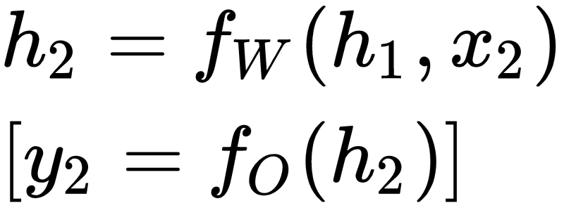
Forward step

Slide 28
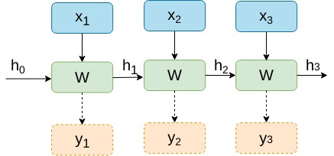
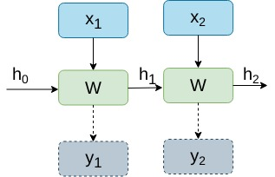
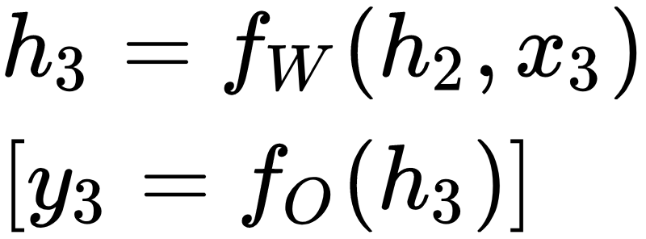
Forward step

Slide 29
Forward step
same W / same O at each time step

Slide 30
Forward step
same W / same O at each time step
allow input sequence of variable lengths
given a context and an input, all timesteps should be process in the same way

Slide 31
Feed-forward vs RNN
MANY - TO - ONE
ONE - TO - MANY
ONE - TO - ONE
MANY - TO - MANY
Notes:
De dat exemple la fiecare

Slide 32
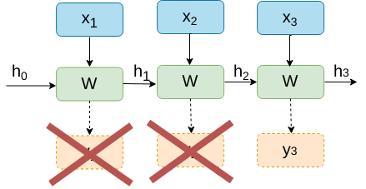
Forward step - single output

Slide 33
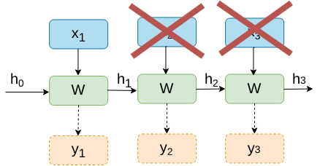
Forward step - single input
DUMMY INPUT

Slide 34
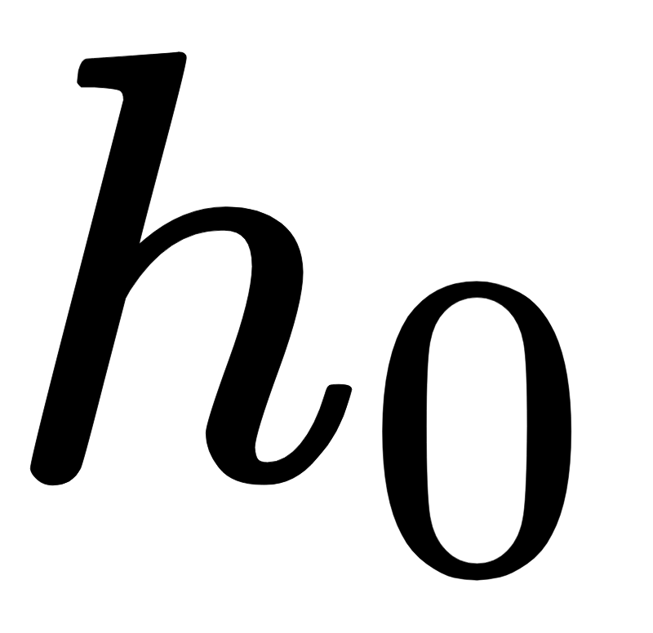
Forward step - initial state
What about ?
zeros vector
random vector
representation of data used as conditional information for current model

Slide 35
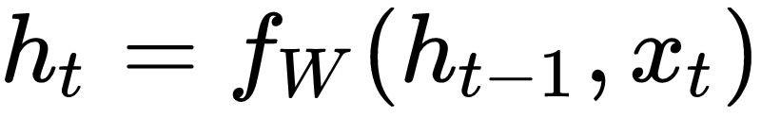
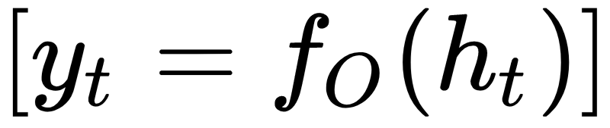
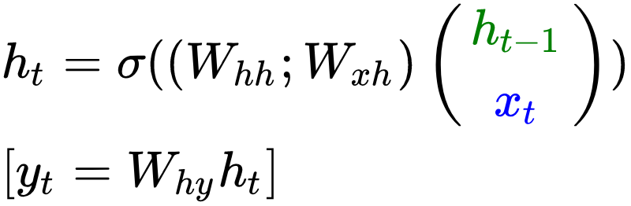
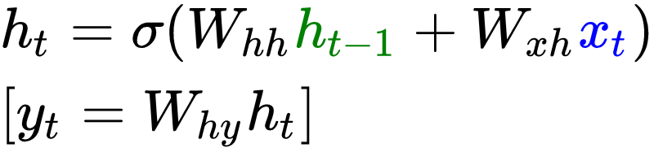

Vanilla RNN

Slide 36
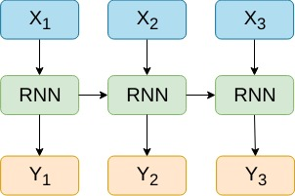
Vanilla RNN vs Multi-modal RNN
One-modal input

Slide 37
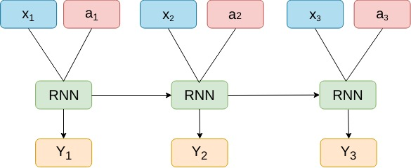
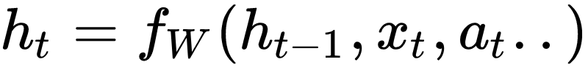
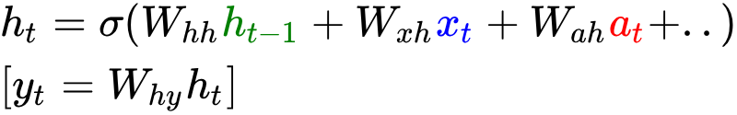
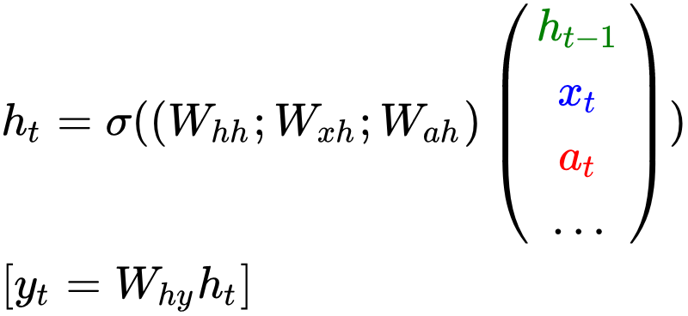
Vanilla RNN vs Multi-modal RNN
One-modal input
Multi-modal input

Slide 38
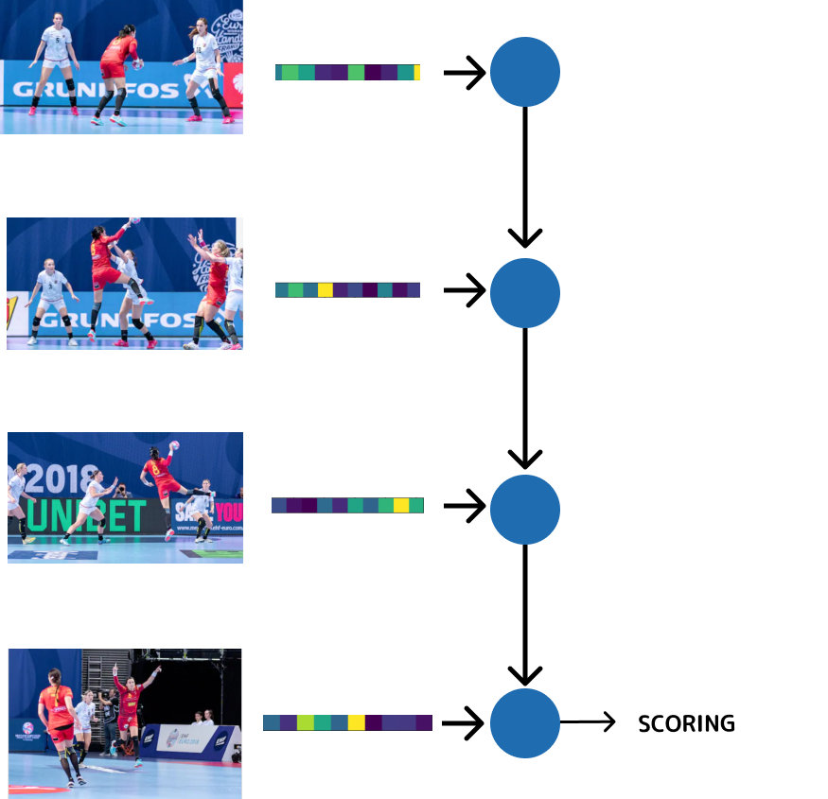
Video classification: RNN
one CNN to extract features
one RNN to process the frames features
output from the final step
(many to one)
Notes:
Sa vb despre faptul ca pot folosi si outpturi intermediare

Slide 39
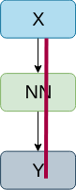



Backpropagation
RECAPa
Loss function (E) measures how close we are to the optimal solution
At train time, update parameters to minimize the loss
The update is based on gradient descent
Notes:
Cum era pana acum?

Slide 40
Backpropagation
RECAPa
Loss function (E) measures how close we are to the optimal solution
At train time, update parameters to minimize the loss
The update is based on gradient descent
We need to compute
Notes:
Cum era pana acum?

Slide 41



Backpropagation through time (BPTT)
Fancy name for regular backpropagation on an unrolled RNN
Notes:
Cum era pana acum?

Slide 42





Backpropagation through time (BPTT)
*
* Slightly change the way we define this, for an easier computation. The intuition remains the same
Notes:
Cum era pana acum?

Slide 43


Backpropagation through time (BPTT)
Notes:
Cum era pana acum?

Slide 44





Backpropagation through time (BPTT)
Notes:
Cum era pana acum?

Slide 45
Backpropagation through time (BPTT)
NO!
Notes:
Cum era pana acum?

Slide 46




Backpropagation through time (BPTT)
YES!
Notes:
Cum era pana acum?

Slide 47

Multivariable Chain Rule
W
x(w)
y(w)
f(x(w), y(w))

Slide 48







Multivariable Chain Rule
W
…

Slide 49




Backpropagation through time (BPTT)

Slide 50


Backpropagation through time (BPTT)

Slide 51



Backpropagation through time

Slide 52


Backpropagation through time
For large number of timesteps (t):
image from: https://hackernoon.com/understanding-architecture-
of-lstm-cell-from-scratch-with-code-8da40f0b71f4

Slide 53


Backpropagation through time
For large number of timesteps (t):
image from Toronto University CSC321 course 2017, R. Grosse

Slide 54


Backpropagation through time
For large number of timesteps (t):
HARD TO TRAIN
WHY?
Notes:
Ce se intampla in fiecare caz?
=> avem nevoie de solutii daca vrem sa le antrenam

Slide 55


Vanishing gradients
unable to capture long-distance dependencies
induce a bias towards recent events
Gradient can be seen as a measure for the impact of the past state for a future state
Notes:
Ce se intampla in fiecare caz?
=> avem nevoie de solutii daca vrem sa le antrenam

Slide 56
Exploding gradients
Bad updates
Huge step reaching a bad configuration
Could result in NaN parameters
Notes:
Ce se intampla in fiecare caz?
=> avem nevoie de solutii daca vrem sa le antrenam

Slide 57


Vanishing / exploding gradients
Solution 1: Gradient clipping
avoid exploding gradients
preserve direction, but a smaller step
Goodfellow et al. Deep Learning.

Slide 58

Vanishing / exploding gradients
Solution 2: Identity initialization
recurrent weights are initialized to the identity matrix
activation functions are ReLU

Slide 59

Vanishing / exploding gradients
Solution 3: Architectures:
LSTM
GRU
avoid vanishing gradients
Sepp Hochreiter and Jürgen Schmidhuber. 1997. Long Short-Term Memory. Neural Comput. 9, 8 (November 1997)
Cho, Kyunghyun et al. “Learning Phrase Representations using RNN Encoder-Decoder for Statistical Machine Translation.” EMNLP (2014).

Slide 60





Gating mechanism
Vanilla RNN
Simple Gate
Gates control the flow of information into the cell, allowing the model to forget irrelevant information
-> easier to retain long-term info (by setting gate to 0)
- dismiss all the information
- keep all the information

Slide 61


GRU
GRU use a gating mechanism with 2 gates:
update gate: determine how much of the past information needs to be passed along to the future
reset gate: determine what parts of previous hidden state are used to compute new content

Slide 62


GRU
GRU use a gating mechanism with 2 gates:
update gate: determine how much of the past information needs to be passed along to the future
reset gate: decide how to combine new input with previous state
keep/reset previous info for current target state
selects useful parts of prev hidden state to compute crt
integrate crt info into the previous one
copy/ignore previous info

Slide 63
Where else?

Slide 64

Where else?
can be a problem for any neural network
use skip-connection to preserve identity
Several architecture: ResidualNet; DenseNet; HighwayNet

Slide 65
Where else?
can be a problem for any neural network
use skip-connection to preserve identity
Several architecture: ResidualNet; DenseNet; HighwayNet

Slide 66

Truncated backpropagation through time (TBPTT)
[slide from Stanford CS231 course 2018, Li Fei-Fei]

Slide 67
Truncated backpropagation through time (TBPTT)
When the sequence is very long, BPTT accumulate gradients over many timesteps:
learning is computationally expensive (slow)
learning suffer from vanishing / exploding gradients
TBPTT:
update step is applied after each sequence of k forward-pass
each update accumulates gradients over a limited, fixed number of timesteps (k)

Slide 68

Truncated backpropagation through time (TBPTT)
[slide from Stanford CS231 course 2018, Li Fei-Fei]

Slide 69

Truncated backpropagation through time (TBPTT)
[slide from Stanford CS231 course 2018, Li Fei-Fei]

Slide 70

Truncated backpropagation through time (TBPTT)
[slide from Stanford CS231 course 2018, Li Fei-Fei]
Notes:
Ce probleme apar?
Timp + memorie + vanishing
Sa zic si de memoria necesara

Slide 71



Classification vs Generation
CLASSIFICATION
GENERATION
[Image from https://www.buzzfeed.com/stephenlaconte/coffee-is-bad-people-who-drink-it-are-bad]

Slide 72

Generate Sequences - Teacher forcing
Language models usually use the output from step t-1 as input for step t
Early mistakes propagates in later steps:
Slow convergence
Instability of model

Slide 73

Generate Sequences - Teacher forcing
Teacher forcing:
during train phase the model receive ground truth y* instead of model output y
later steps receive correct input even in the beginning of training
during test phase use the model’s output, because we don’t have access to the ground truth
Notes:
Sa vorbesc si de sampling vs max

Slide 74

Process longer input
Problem:
can’t fit the entire document in the model
need batch_size > 1
need previous context for each sub-sequence
Fragment from: Rebilius Cruso (Francis William Newman) http://www.gutenberg.org/files/50732/50732-h/50732-h.html

Slide 75

Process longer input
Problem:
can’t fit the entire document in the model
need batch_size > 1
need previous context for each sub-sequence
Solution:
split document in batch_size continuous chunks
one batch receive, in each training iteration, sequences from different chunks

Slide 76

Process longer input
Problem:
can’t fit the entire document in the model
need batch_size > 1
need previous context for each sub-sequence
Solution:
split document in batch_size continuous chunks
one batch receive, in each training iteration, sequences from different chunks

Slide 77

Multilayer RNN
better capture the structure of the input sequence
might be harder to optimize (longer paths)

Slide 78


Bidirectional RNN
prediction at timestep t depend on the whole input
combine context from 2 RNNs: a forward RNN and a backward RNN
Schuster, Mike and Kuldip K. Paliwal. “Bidirectional recurrent neural networks.” IEEE Trans. Signal Processing 45 (1997): 2673-2681.
Notes:
Subliniat ca sunt 2 rnnuri diferite, independente pana la output

Slide 79
RNNs pros
can handle input of variable length
each step can depend on context from many steps back
symmetric, intuitive processing

Slide 80

Why not RNNs?
source
RNNs are not parallelizable
linear interaction distance:
maximum path length between distant elements is O(n)
long term dependencies still tricky to learn, even with gating mechanisms (LSTM, GRU etc.)

Slide 81

Alternative approaches for Sequential Data

Slide 82

Transformer (2017)
no RNNs: introduces multi-head self-attention
SOTA on Machine Translation (EN-DE, EN-FR)
lower computational cost: ¼ FLOPs of previous models

Slide 83

Self-Attention
each state depends on all of the others, not only the previous one

Slide 84

Self-attention blackbox
Two steps for output i:
identify the most ‘relevant’ features for input i, by ‘looking’ at all the other input words => attention scores
extract the most relevant features by combining inputs with attentions scores
0.1*The + 0.2*Broadway + 0.2*play + 0.4*premiered + 0.1*yesterday
0.1*The + 0.1*Broadway + 0.1*play + 0.3*premiered + 0.4*yesterday
outputs
inputs

Slide 85


Key, Query and Value analogy
Scenario: I want to research a topic and I need relevant content to look through:
query - research topic
key - folder name
value - folder content
figures from http://jalammar.github.io/illustrated-gpt2/

Slide 86

Self-attention steps
compute attention scores by taking dot products between query and keys
figure from http://jalammar.github.io/illustrated-transformer/

Slide 87
Self-attention steps
compute attention scores by taking dot products between query and keys
scale and normalize attention scores

Slide 88
Self-attention steps
compute attention scores by taking dot products between query and keys
scale and normalize attention scores
contextual embedding for each word is the weighted sum of values and their attention scores

Slide 89

Self-attention is parallelizable
context vectors are computed simultaneously for all input vectors
complexity: O(N²d)
figure from http://jalammar.github.io/illustrated-transformer/

Slide 90


Positional Awareness
Self-attention has no temporal order information:
the cat sat on the mat
the mat sat on the cat
figure from http://www.poetrypicture.club/the-cat-sat-on-the-mat/

Slide 91

Positional Encoding
add position-aware encodings to the word embeddings so that order matters
these encodings are either:
fixed and precomputed (no learned parameters)
learned embeddings
figure from http://jalammar.github.io/illustrated-transformer/
Notes:
For an in-depth explanation of the original fixed positional encoding (used in ‘Attention is all you need’), see this resource: https://kazemnejad.com/blog/transformer_architecture_positional_encoding/

Slide 92

Masked self-attention
inputs should not ‘peak’ into the future
each input can only ‘attend’ to previous inputs
figure from figure from http://jalammar.github.io/illustrated-gpt2/

Slide 93
Transformer block
multi-head self-attention is part of Transformer block
other key ingredients:
residual connections
layer normalization
FC layer after self-attention

Slide 94


Multi-head self-attention
multiple self-attention heads can learn different relationships

Slide 95
Transformer block - recap
recurrent-free, parallelizable alternative for sequence processing
lower complexity than RNNs: O(N²d) vs O(Nd²)
constant gradient path (every element directly interacts with all the other elements)
building block for SOTA architectures in NLP (BERT, GPT-2)

Slide 96



Ongoing research
Self-attention / Transformer:
for long sequences, the number of pairwise computations increases dramatically
Kitaev et al., Reformer: The Efficient Transformer
Wang et al., Linformer: Self-Attention with Linear Complexity
Choromanski et al., Rethinking Attention with Performers

Slide 97
TODAY
RNNs are good for sequential data
RNNs allow flexibility in architecture
BPTT suffer from vanishing / exploding gradients
clipping gradients and LSTM/GRU architectures are common ways to avoid them
self-attention is a parallelizable alternative to recurrent networks

Slide 98
Thank you!
(Next: Natural Language Processing Applications)

Slide 99
Other Resources
http://www.cs.toronto.edu/~rgrosse/courses/csc321_2018/ - Lectures 15-16
https://www.cs.ox.ac.uk/people/nando.defreitas/machinelearning/ - Lecture 12-13
http://cs231n.stanford.edu/slides/2017/cs231n_2017_lecture10.pdf - Lecture 10
http://cs224d.stanford.edu/syllabus.html Lecture 6-8
http://karpathy.github.io/2015/05/21/rnn-effectiveness/
GRU: https://arxiv.org/abs/1406.1078
LSTM: https://www.bioinf.jku.at/publications/older/2604.pdf

